Slide 1
ENG 358: True Crime aka
Tricking Non-Majors into Literary Analysis
Liz W Faber, PhD
Associate Professor of English & Communication
Dean College
efaber@dean.edu
www.lizwfaber.com

Slide 2

Context: Dean College
Undergrad-Only SLAC
Franklin, MA
~1200 Students
Largest majors:
  Dance (B.A.; B.F.A.)
  Business (B.S.)
  Communications (B.A.)
  Criminal Justice (B.S.)
Liz W Faber, PhD | efaber@dean.edu | lizwfaber.com

Slide 3
Context: Written & Oral Comm Competencies
ENG 358: True Crime
100-level
Comp I
Comp II
200-level
CD Hum. (1)
300-level
Capstone
Speech Comm
400-level
UDLA (3)
Applied Prof. Comm.
Liz W Faber, PhD | efaber@dean.edu | lizwfaber.com

Slide 4

Course Development: Needs
Creative Nonfiction Studies Course
Address apathy about reading & literary analysis
Pre-Capstone Advanced Writing Instruction
  Process Writing
  Scholarly Sources
  Literature Review
  12-15 Page Thesis-Driven Essay
Liz W Faber, PhD | efaber@dean.edu | lizwfaber.com

Slide 5
Course Development Timeline
Spring 2022
Assessment results – established need
Summer 2022
Course proposal submitted (part of omnibus changes)
Fall 2022
Proposal approved
Fall 2023
First run
Fall 2025
Second run
Liz W Faber, PhD | efaber@dean.edu | lizwfaber.com

Slide 6

Course Design: Description
This course examines the true crime genre, through print, documentaries, and podcasts. Throughout the semester, we will encounter a variety of types of crimes and criminals, from cold cases to serial killers to wrongful convictions. We will consider what these real-life stories teach us about the nature of truth, media ethics, and law. We will also compare and contrast themes, archetypes, and storytelling techniques used across media to make up the true crime genre as we know it today. Prerequisite English 112 and junior or senior standing, or permission of the Dean of the School of Liberal Arts and Sciences. Offered in the Fall semester of every odd year.
Liz W Faber, PhD | efaber@dean.edu | lizwfaber.com

Slide 7
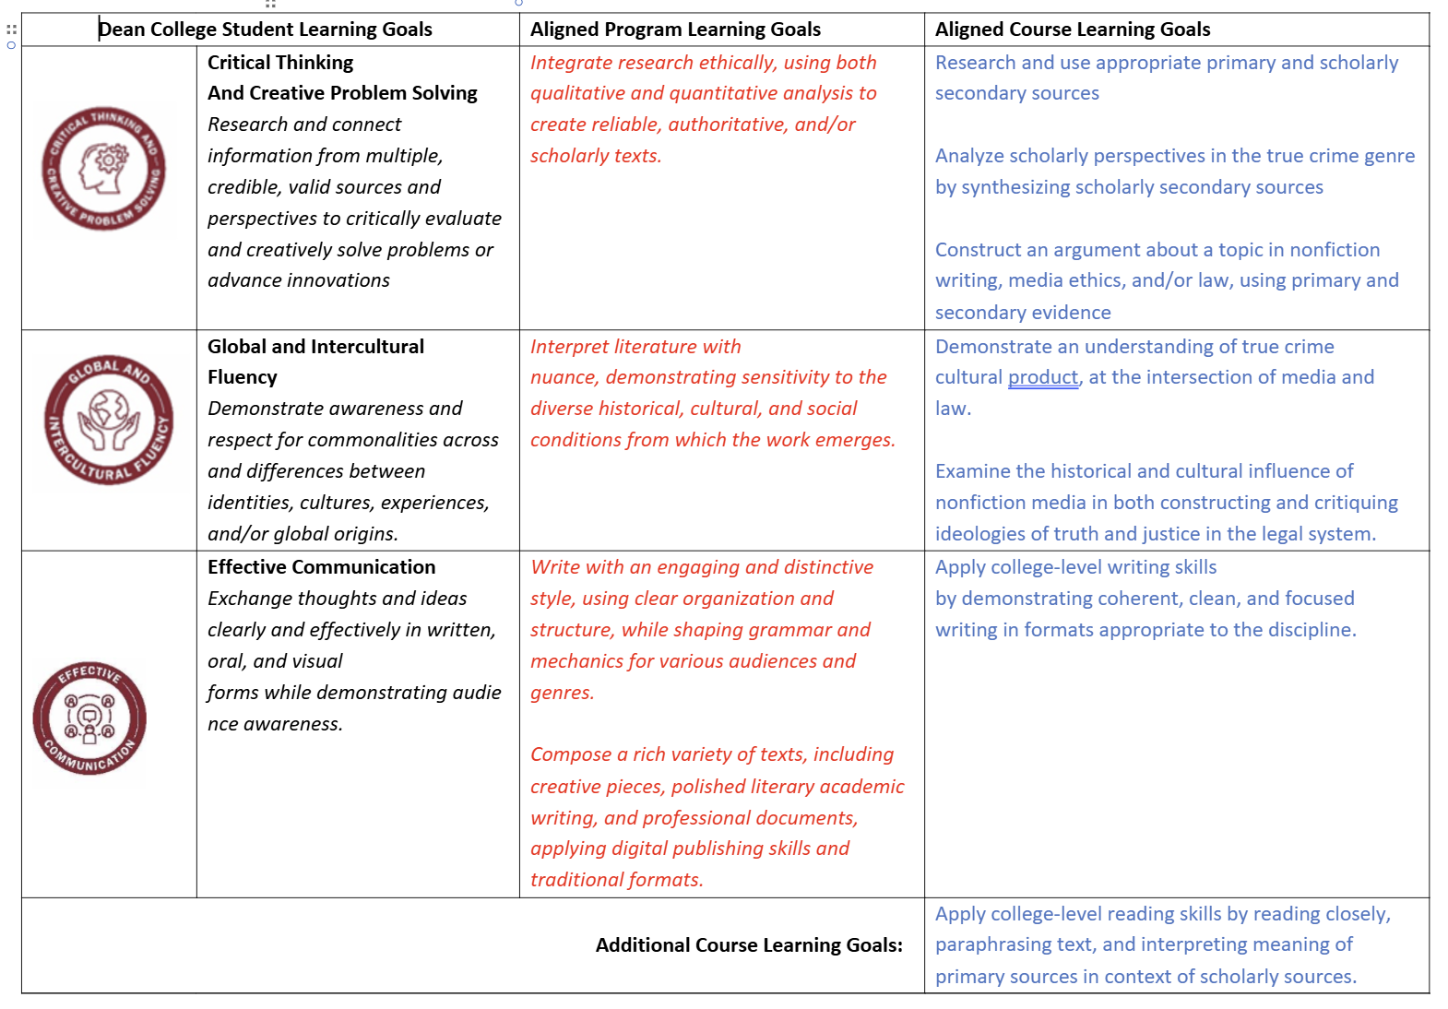
Course Design: Learning Goals
Liz W Faber, PhD | efaber@dean.edu | lizwfaber.com

Slide 8
First Run (Fall 2023)
Positives
At cap start to finish!
Negatives
Low in-class participation
Excitement about topic!
Poor basic writing skills
Text Annotation
Essay organization
Thesis statements
Analysis
Evidence sandwiches
Conclusions
Unclear focus
Media + Law + Literature
Case-oriented, not Literature-oriented
Fun field trip!
Liz W Faber, PhD | efaber@dean.edu | lizwfaber.com

Slide 9
Course Revision
Aspect of Course | Fall 2023 → Fall 2025
Description | No Change
Goals | No Change
Course texts | Revised
Assignment Weights | Revised
Assignments | Revised
In-Class Activities | Revised
Field Trip | Revised
Liz W Faber, PhD | efaber@dean.edu | lizwfaber.com

Slide 10





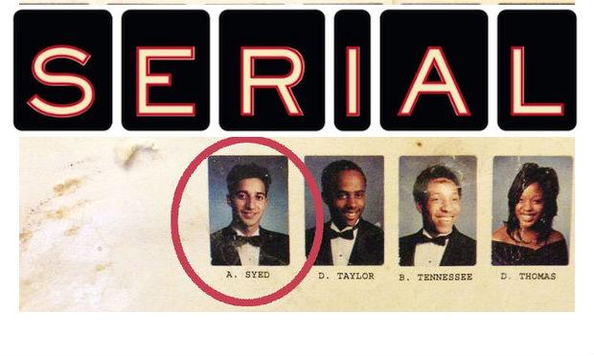
Course Design & Revision:
Primary Texts
2023
2025
Liz W Faber, PhD | efaber@dean.edu | lizwfaber.com

Slide 11
Course Design & Revision:
Secondary Texts
2023
Case-related
2025
Text- and genre- related
Mix of popular & scholarly
1 article per primary text
Disconnected from final essay
Mostly scholarly
3 foundational articles + 1 article per primary text
Required source for final paper
Liz W Faber, PhD | efaber@dean.edu | lizwfaber.com

Slide 12
Course Revisions:
Assignment Weights
Fall 2023 | Fall 2025
Case Reports: 35% Midterm Project: 20% Final Essay: 45% | In-Class Activities: 20% Weekly Serial Discussion: 10% Four Case Analysis Essays: 40% Final Essay: 30%
Liz W Faber, PhD | efaber@dean.edu | lizwfaber.com

Slide 13
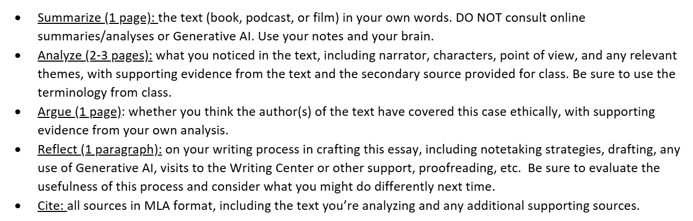
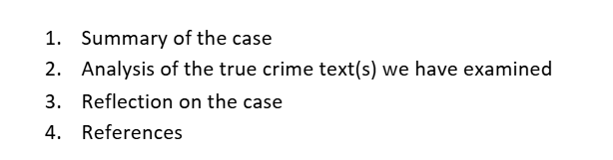
Course Design & Revisions:
Assignments
Fall 2023 | Fall 2025
Case Reports: 35% Midterm Project: 20% Final Essay: 45% | In-Class Activities: 20% Weekly Serial Discussion: 10% Four Case Analysis Essays: 40% Final Essay: 30%
2023
2025
Liz W Faber, PhD | efaber@dean.edu | lizwfaber.com

Slide 14
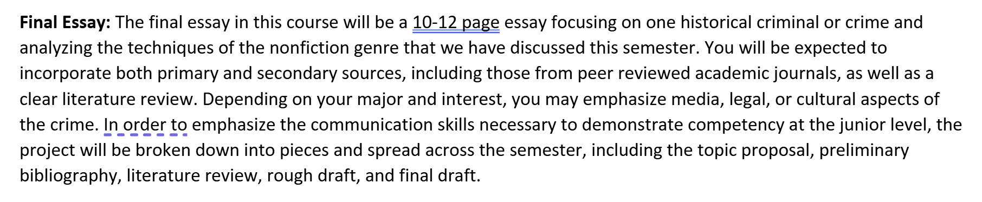
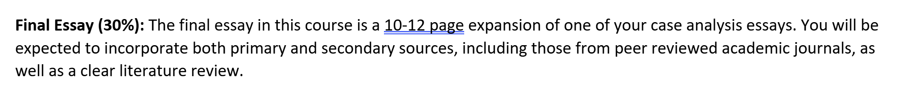
Course Design & Revisions:
Assignments
Fall 2023 | Fall 2025
Case Reports: 35% Midterm Project: 20% Final Essay: 45% | In-Class Activities: 20% Weekly Serial Discussion: 10% Four Case Analysis Essays: 40% Final Essay: 30%
2023
2025
Liz W Faber, PhD | efaber@dean.edu | lizwfaber.com

Slide 15
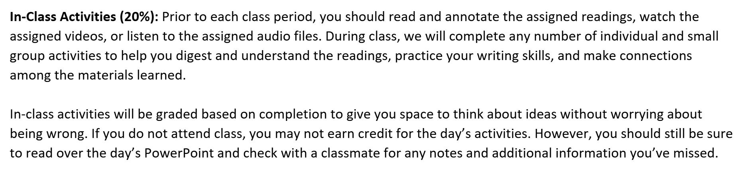
Course Design & Revisions:
Assignments
Fall 2023 | Fall 2025
Case Reports: 35% Midterm Project: 20% Final Essay: 45% | In-Class Activities: 20% Weekly Serial Discussion: 10% Four Case Analysis Essays: 40% Final Essay: 30%
2025 only

Slide 16
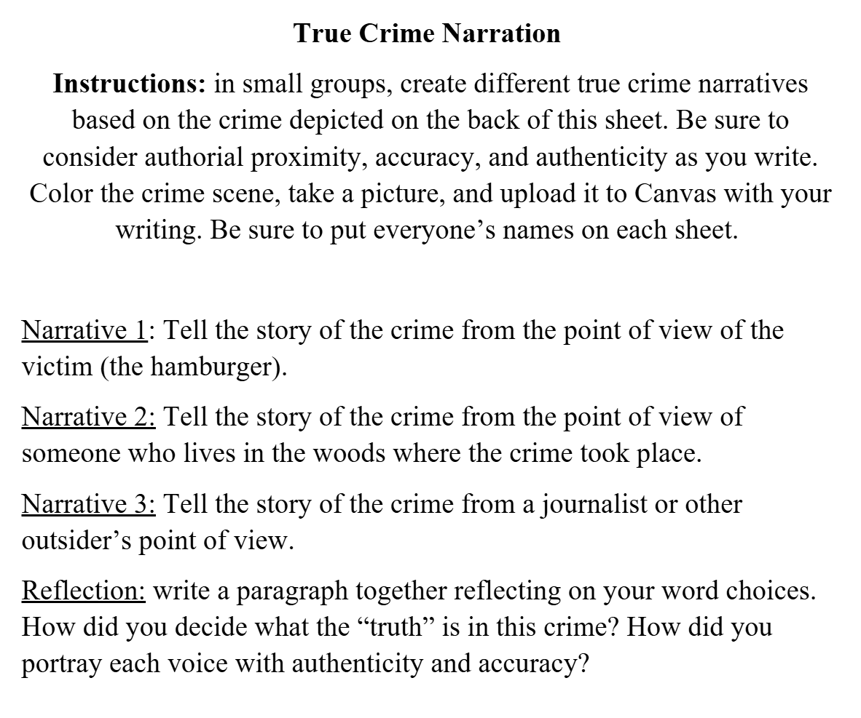

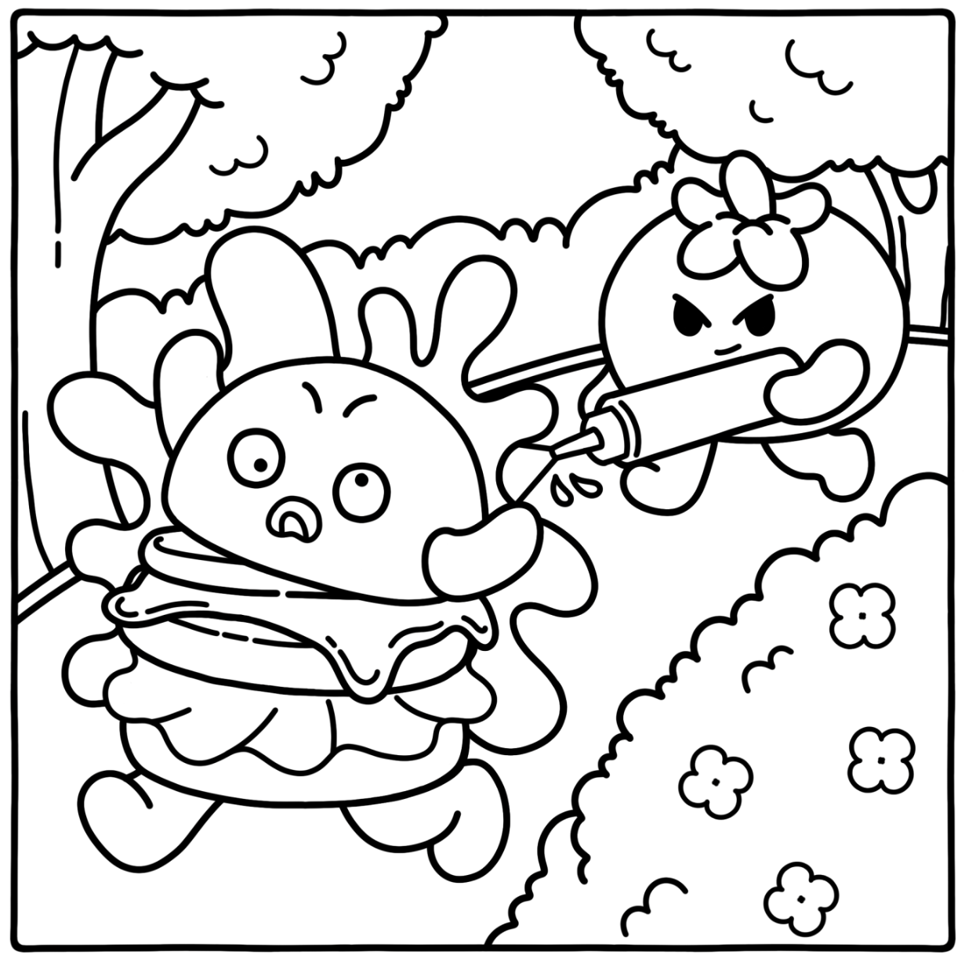
Sample In-Class Activity
Homework Reading
The Crime Scene
Instruction Sheet

Slide 17
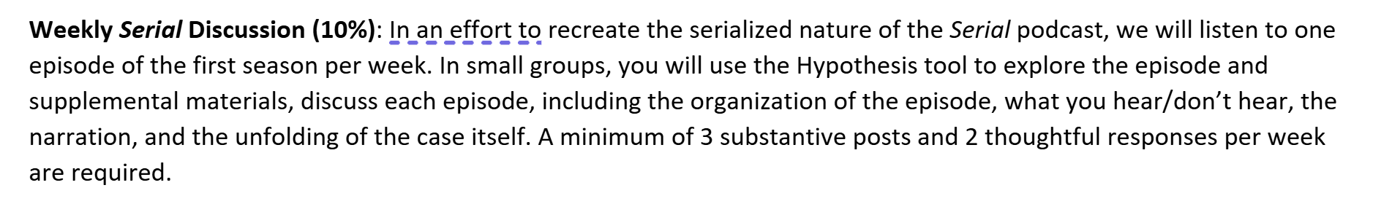
Course Design & Revisions:
Assignments
Fall 2023 | Fall 2025
Case Reports: 35% Midterm Project: 20% Final Essay: 45% | In-Class Activities: 20% Weekly Serial Discussion: 10% Four Case Analysis Essays: 40% Final Essay: 30%
2025 only
Liz W Faber, PhD | efaber@dean.edu | lizwfaber.com

Slide 18

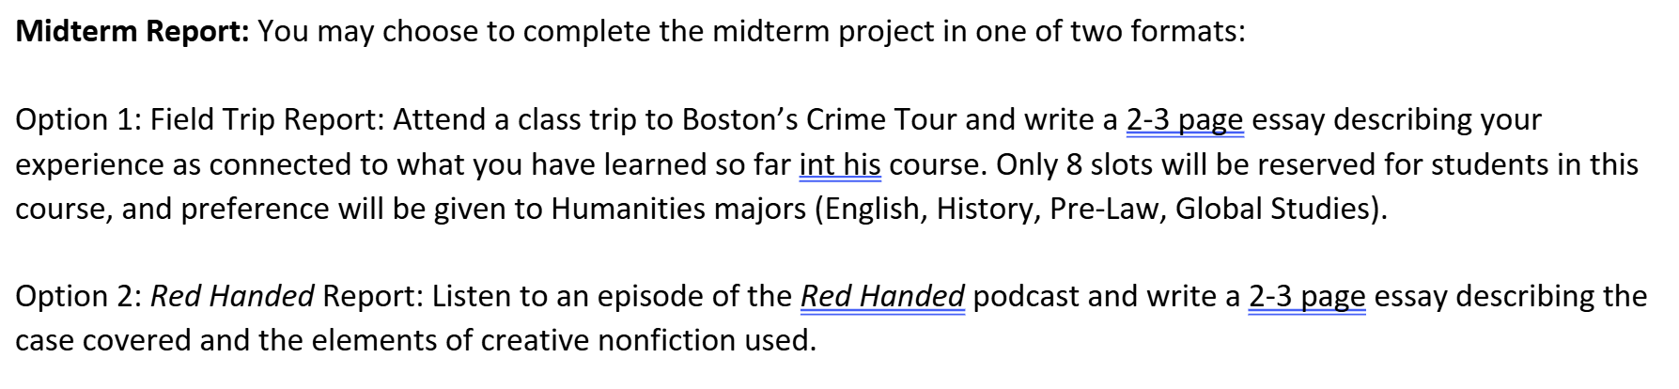
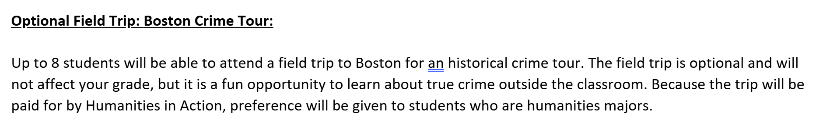

Course Design & Revisions:
Field Trip
2023
2025
Liz W Faber, PhD | efaber@dean.edu | lizwfaber.com

Slide 19
Second Run (Fall 2025)
Positives
Filled in 1st hour of registration!
Negatives
Not enough in-class writing time
High in-class participation
Tracked writing skill development throughout course
Emphasized process writing
Clear focus: creative non-fiction and the true crime genre
Deeper discussions about truth and storytelling
Less incentive to attend field trip
Liz W Faber, PhD | efaber@dean.edu | lizwfaber.com

Slide 20

Thank You!
Course materials are on my website: lizwfaber.com
Email me: efaber@dean.edu

