Slide 1
Unit 3: The Open Letter
ENG 101
Fall 2019
Dr. Faber

Slide 2
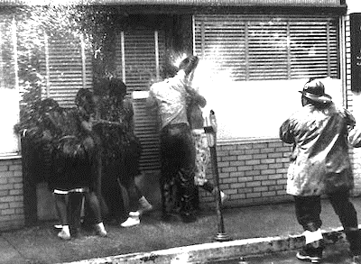
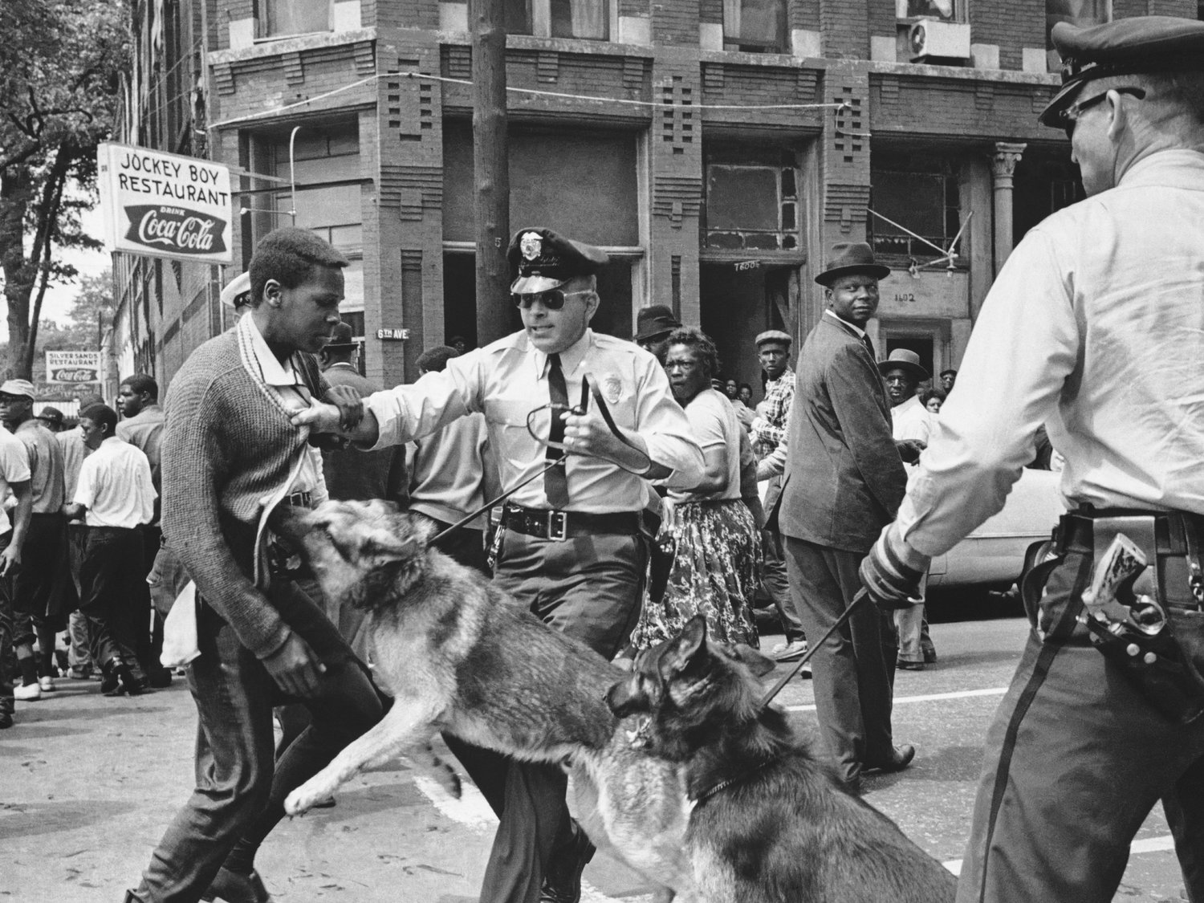
Nonviolent Protests: The Birmingham Campaign
Nonviolent effort to end racial segregation and discrimination in Birmingham, Alabama
Led by SCLC, with Martin Luther King, Jr., other leaders, and college students
Nonviolent protesters brutalized by white police
~50 people arrested, including MLK
News photographers documented the violence

Slide 3
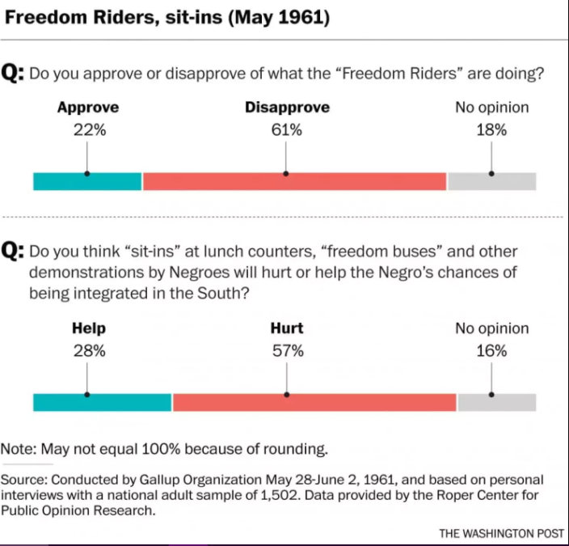
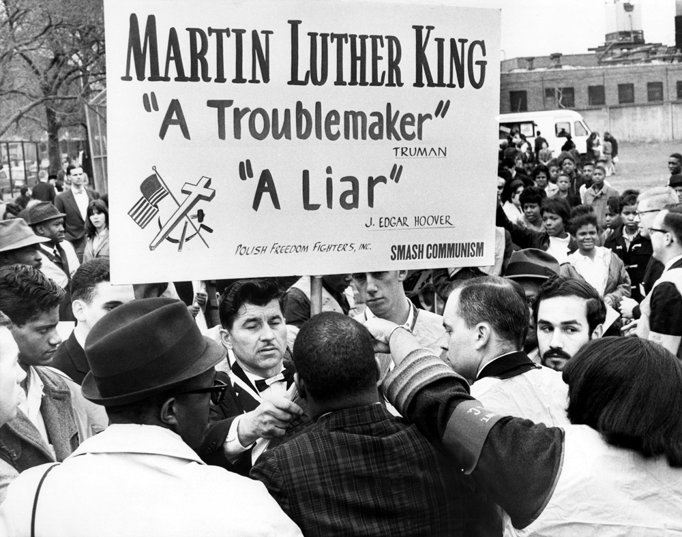
Nonviolent Protests: What Did People Think?

Slide 4
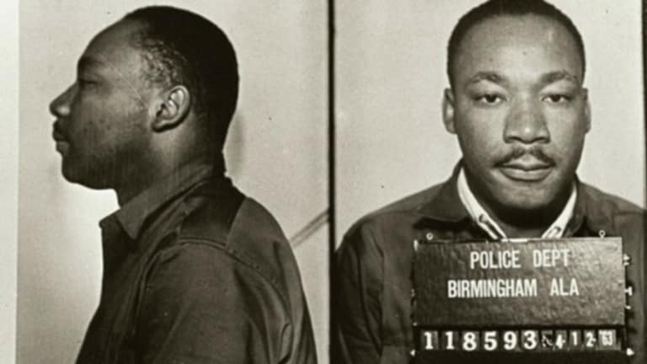
“A Call for Unity” & “Letter from Birmingham Jail”
April 12, 1963 Statement condemning SCLC’s Birmingham campaign
Signed by 8 clergymen
Published in a newspaper, which was brought to King in the Birmingham jail.
King’s response is now known as “Letter from Birmingham Jail”

Slide 5
Activity
Work in groups of 3-4 to translate “A Call for Unity” and “Letter from Birmingham Jail” into a text message exchange between the clergy and Dr. King. Be sure to use the rhetorical situation of the text message (i.e. use text speak, emojis, gifs, etc.) while accurately capturing the claims made by each side of the discussion.
Create one document per group, with each group member’s names on it. Upload the document to Blackboard when you’re finished.
Be prepared to share with the class!

Slide 6
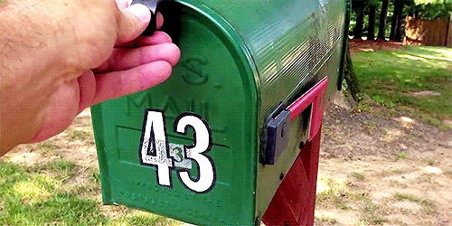
Essay 3: The Open Letter
Content Requirements
Topic Parameters
Form Requirements
Letter Formatting Template
Rubric

Slide 7
Group Brainstorming
As a class, use the white board to make 6 lists of problems or issues faced by each of the communities you live in
  1. DCC’s campus
  2. Your place of work/Your Industry
  3. The town you live in
  4. Dutchess County
  5. New York State
  6. The United States

Slide 8
Individual Brainstorming
Look through the issues on the board and identify a few that interest you.
Use Google to locate a statement put out by a community leader regarding each issue. Statements could include a speech, an Op-Ed piece published in a newspaper, a tweet, etc. Make sure you copy/paste the URLs into a Word Doc so you have a running list. (If there’s one issue on the list you made that you care most about, just look up that one.)
Look through the statements you’ve identified. Which do you care most about? Why?

