Slide 1
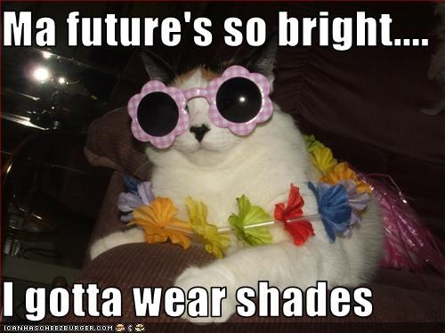
How to Succeed in College Without Really Trying
Study Skills Workshop
Dr. Faber
Tutoring Coordinator, Academic Resource Center
2019
Image Source: https://profanegermane.files.wordpress.com/2013/03/this-cat-has-a-brighter-future-than-me.jpeg
(Just kidding! It takes effort!)

Slide 2
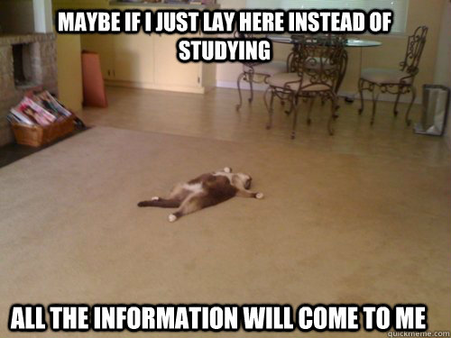
How do you study?
Image source: http://www.quickmeme.com/meme/35ylml

Slide 3

Keep a Schedule
Establish a practical scheduling system
Keep a calendar
  Use your syllabi to fill it in at start of semester
  Update it right away
  Review it before going to bed
Keep task lists
  MAP My Week handout
Image Source: https://www.su.ucalgary.ca/wp-content/uploads/2018/01/naps-should-always-be-on-your-agenda-21618981.png

Slide 4
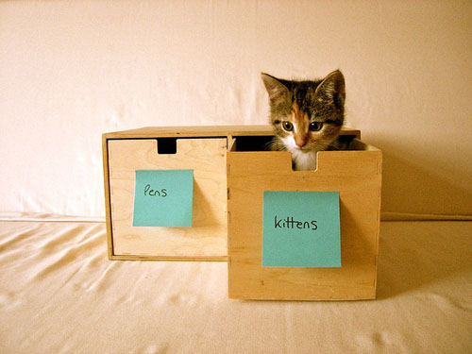
Stay Organized
Keep separate folders and notebooks for each class
Color code your classes
Use big rubber bands to keep individual class materials together
Develop a practical storage system in your room
Image source: http://laughingsquid.com/pens-kittens/

Slide 5

Go to Class!
Arrive a few minutes early
Let your professors know when you can’t make it
  Don’t ask “Did I miss anything important?”
Print out the powerpoints and take notes directly on them.
If you feel bored, write down EVERYTHING
Ask and answer questions
  If you say the wrong thing, you won’t burst into flames. I promise.
Silence your cell phone and keep it in your bag
Disable your laptop wifi
Image Source: https://www.mvshospital.com/wp-content/uploads/2015/10/Cat-Classroom.jpg

Slide 6
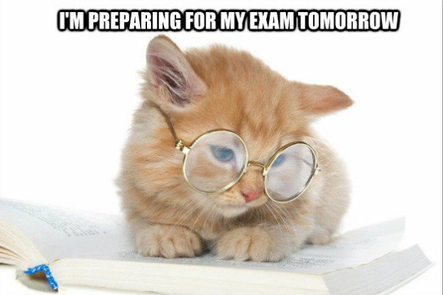
Develop Consistent Study Habits
Study at the same day and time every day
Create a study playlist that never changes
Study in a designated work space
Copy/review notes from class every evening
https://az616578.vo.msecnd.net/files/2016/05/07/6359826041422189501087476345_tumblr_nqs3vau3hb1tyr8woo1_r1_1280.jpg

Slide 7
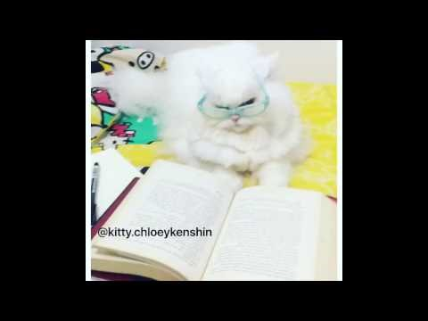
Find a Good Study Buddy

Slide 8

Do the Readings
Use colored pens for underlining/notetaking
Take notes in the margins
Use physical book or printout
Write chapter summaries
Image Source: http://imgur.com/gallery/VZe5ZpK

Slide 9
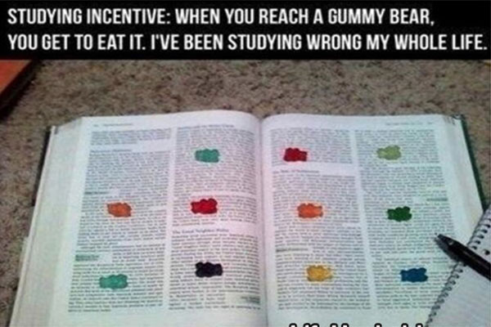
Give Yourself Tiny Rewards
Image Source: http://www.teen.com/2015/08/13/random-stuff/back-to-school-hacks-tips-tricks/?_rtu=RqXQmXcHSpG5L1U7wKmkTw%2B

Slide 10
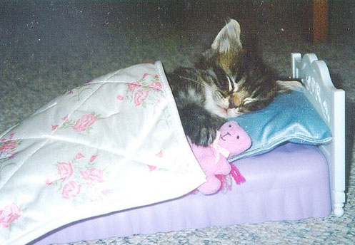
Prepare for Your Exams
Study consistently over time!
Review notes
Make flashcards
Handwrite a study guide using color-coded pens
Eat, hydrate, get lots of rest the night before
Image Source: http://weruletheinternet.com/2012/01/10/22-pictures-of-cats-tucked-in-for-bed/

Slide 11
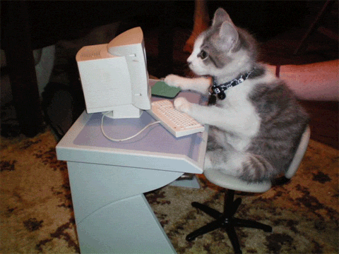
Write Your Papers
Start early!
Write an outline
Take the outline to the professor
Make drafting schedule and stick to it
Find a writing buddy in class to help keep drafting deadlines
Take a draft to the Writing Center
GIF source: http://giphy.com/search/typing-cat/3

Slide 12
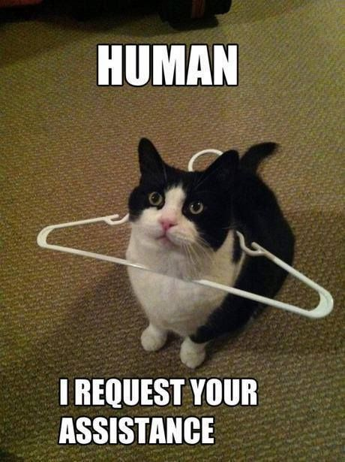
Ask for Help
Visit your professor’s office hours regularly
Visit the Writing Center regularly
Make regular appointments with a Peer Tutor in the ARC
Go to SI review sessions every week
Image Source: http://gpp.blogs.emmanuel.edu/wp-content/uploads/sites/41/2015/10/helping-hands-meme.jpg

Slide 13

Take Care of Yourself!
Eat!
Drink water!
Sleep!
Exercise!
Have fun!
Image source: https://img.memecdn.com/Yoga-Cat_o_8216.jpg

Slide 14

Own Your Education
All knowledge is useful, so learn everything you can.
Introduce yourself to the faculty and staff you encounter
Push yourself to try new subjects and get out of your academic comfort zone
Image source: http://2.bp.blogspot.com/-usAgOj4M3fQ/VhAzOqNmbeI/AAAAAAABfXM/rUXb_-nOMMg/s1600/drivemyown.jpg

Slide 15

Academic Resources on Campus
Professors
  When in doubt, ask us! Our job is to help you!
  Office Hours
    Listed on syllabus
    Bring a friend if you’re nervous!
  E-mail
    Use formal e-mail etiquette
Librarians
  Reference Desk
  First Year Writing Librarian
Image source: https://imgflip.com/s/meme/Chemistry-Cat.jpg

Slide 16
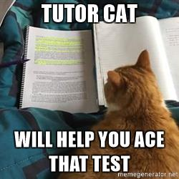
Academic Resources on Campus
The Writing Center
  Walk-in writing clinic in Library 122
  http://mville.digication.com/Andrew-bodenrader-writing-center
  Contact:
    Prof. Brower, Director
    Carleigh.Brower@mville.edu
    Library 119
The Academic Resource Center (ARC)
  Weekly Supplemental Instruction Sessions
  One-on-one or small group tutoring by appointment
  http://mville.digication.com/mvillearc
  Contact:
    Dr. Faber, Tutoring Coordinator
    Elizabeth.Faber@mville.edu
    Lib 121
Image source: https://memegenerator.net/Tutor-Cat

Slide 17

Questions? Concerns?
Image source: https://i.kym-cdn.com/photos/images/facebook/000/665/819/b7b.jpg

