Slide 1
Re-Animating Your Classroom:
Practical Activities
CTLS Common Read Presentation
September 7, 2016
Carleigh Brower, Director of Academic Writing
Liz Faber, Tutoring Coordinator

Slide 2
Classroom Activity: Intertextuality
Passage from Novel
Adaptation
3rd Text

Slide 3
Activity Goals
Develop close reading/textual analysis skills
Practice using different analytical lenses
Consider the connections among multiple texts
Examine how cultural norms, ideals, and categories are constructed over time

Slide 4
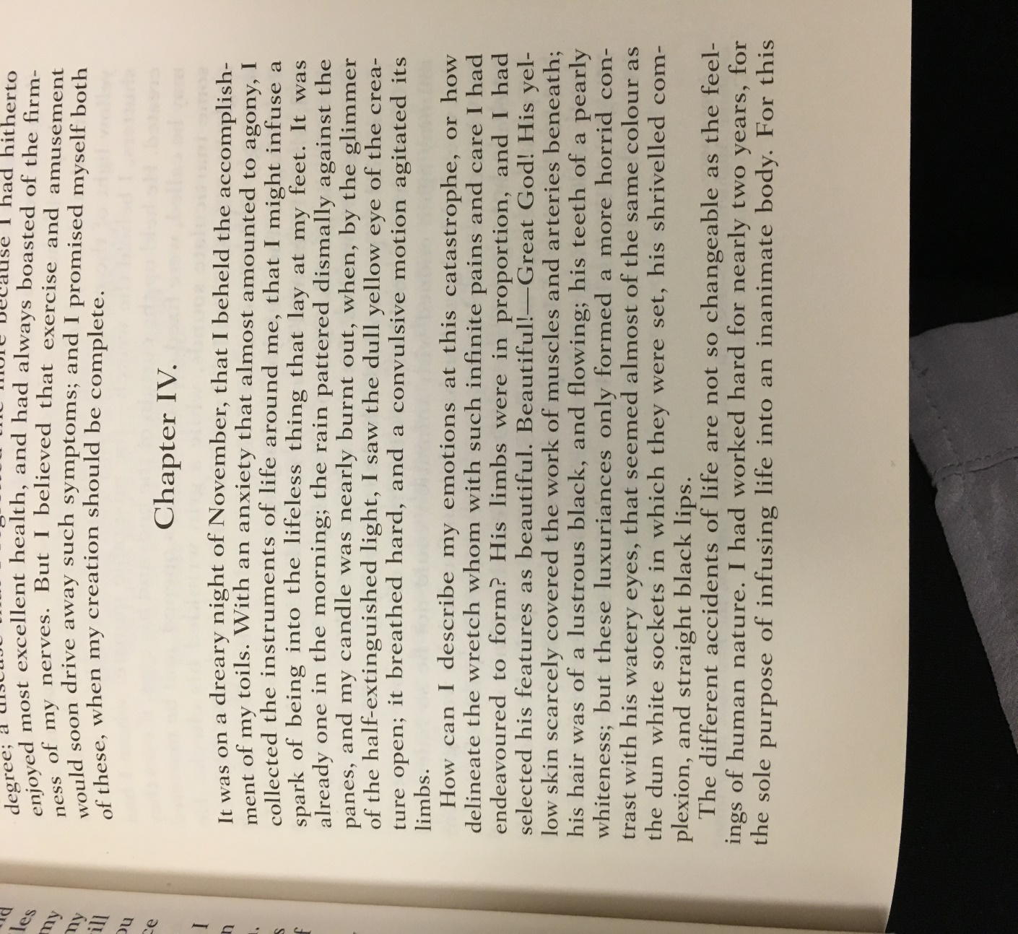
Passage from Novel
Page 35: the creation of the monster

Slide 5
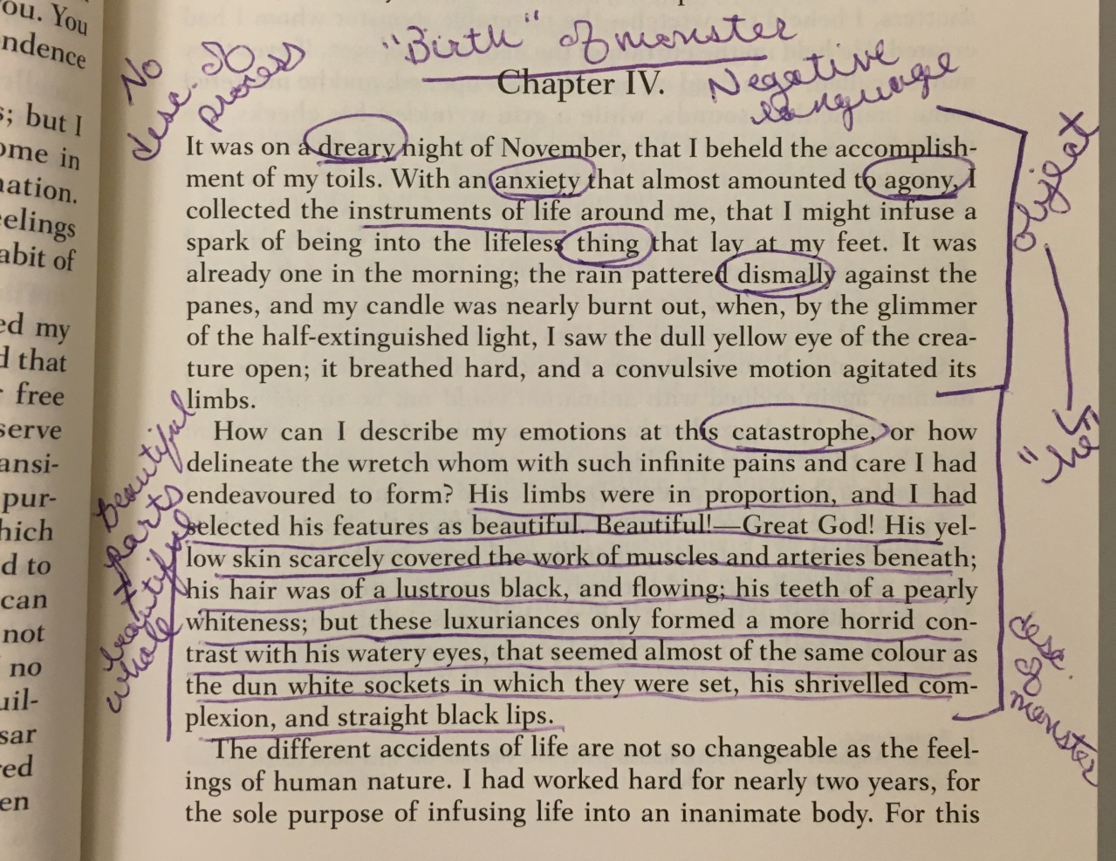
Active Reading Strategy

Slide 6
Active Viewing Strategy: Individual Work
Film Notes Graphic Organizer

Slide 7
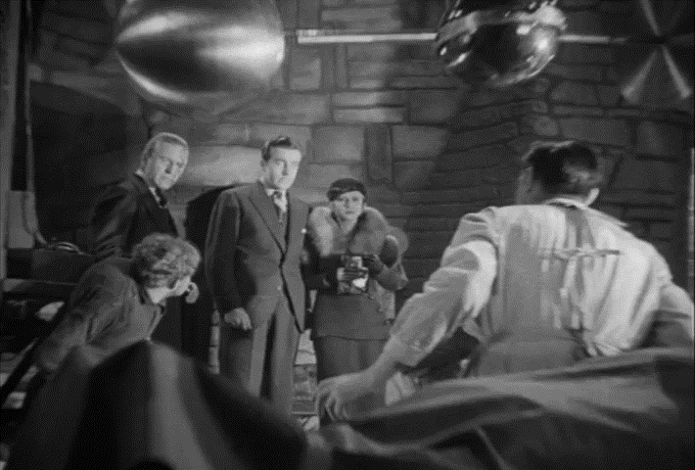
Adaptation: Frankenstein (James Whale, 1931)

Slide 8
Active Viewing Strategy: Group Work
Graphic Organizer

Slide 9
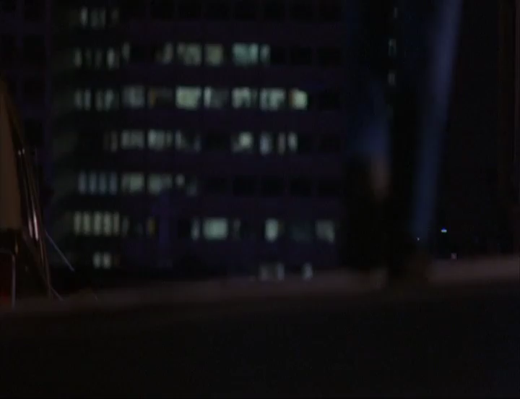
3rd Text: Electric Dreams (Steve Barron, 1984)

